Slide 1


CTEIS Reports
Douglas Wiesner, Ph. D. PTD Technology

Slide 2

How to use CTEIS Reports to answer Common Questions
Doug Wiesner, Ph.D.
PTD Technology
Slide deck available at
Support.CTEIS.com/Resources/Presentations

Slide 3
Common Follow Up Question
How CTEIS reports can answer them
I want to give my teachers more feed back from the Follow Up Surveys
X0610, X0611, T1608 by CIP Code
Survey Exports

Slide 4
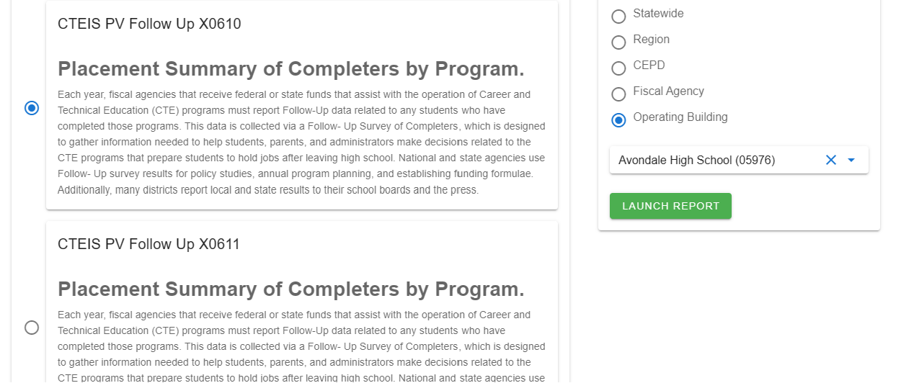
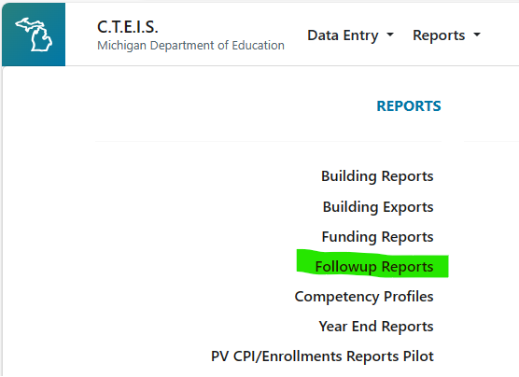
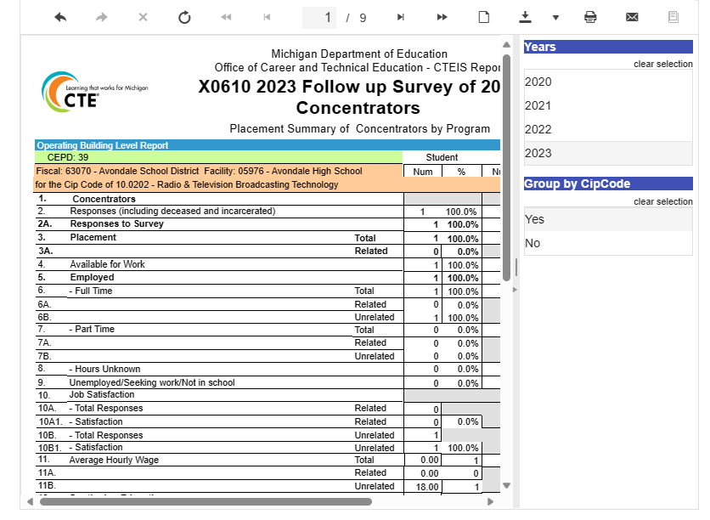
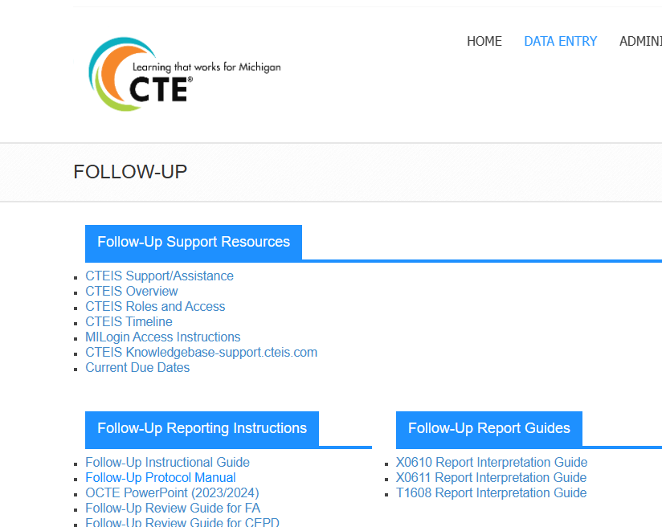
Follow Up Reports
X0610, X0611, T1608 by CIP Code
Can use to provide to teachers so they can see how their students responded.
Interpretation Guides are found on Support Pages

Slide 5
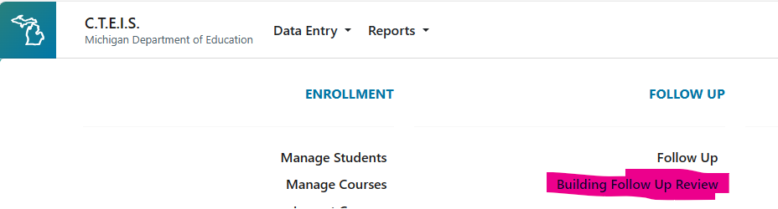
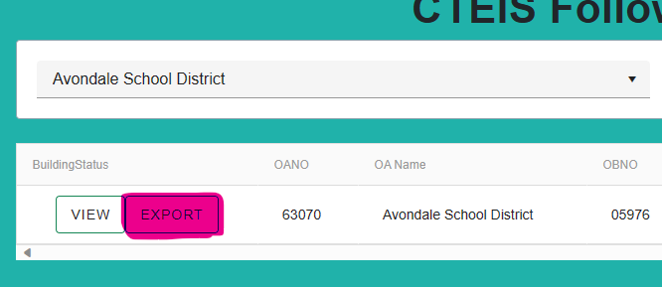
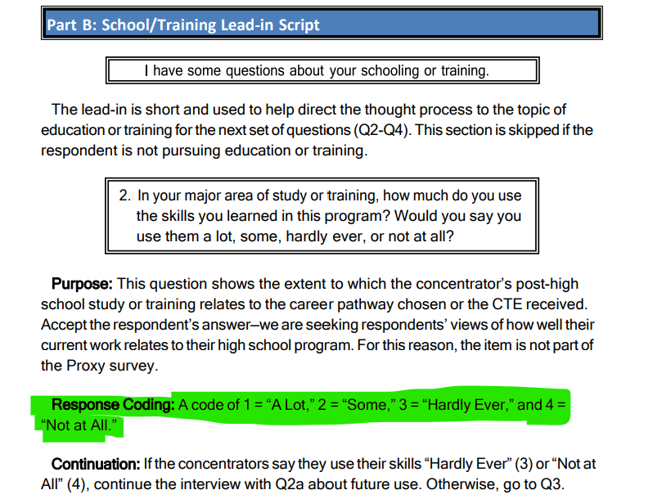
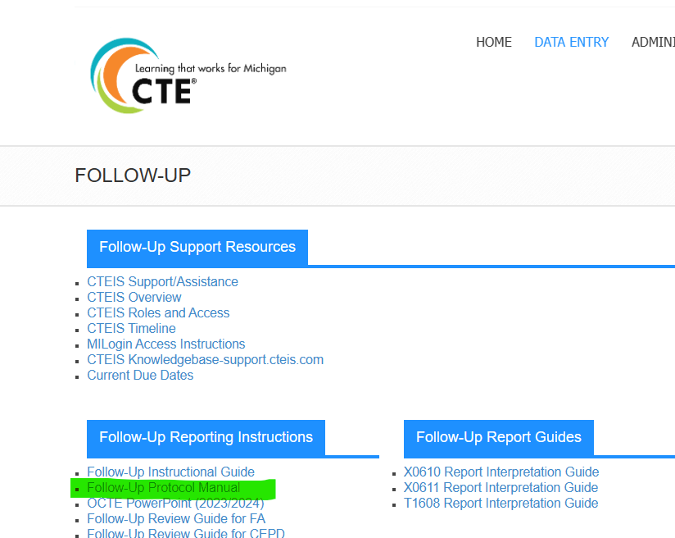
Follow Up Reports
Survey Exports
Building Follow Up Review Page
Survey Response Key found in Protocol Manual

Slide 6
Common Enrollment Issues
Where are all my concentrators/completers?
How CTEIS reports can answer them
How many CTE Students/Enrollments do I have?
How many Courses do I have?
Are my students properly enrolled?
Are my students receiving Segments/Competencies they deserve?
Do my Courses produce Concentrators and Completers?

Slide 7
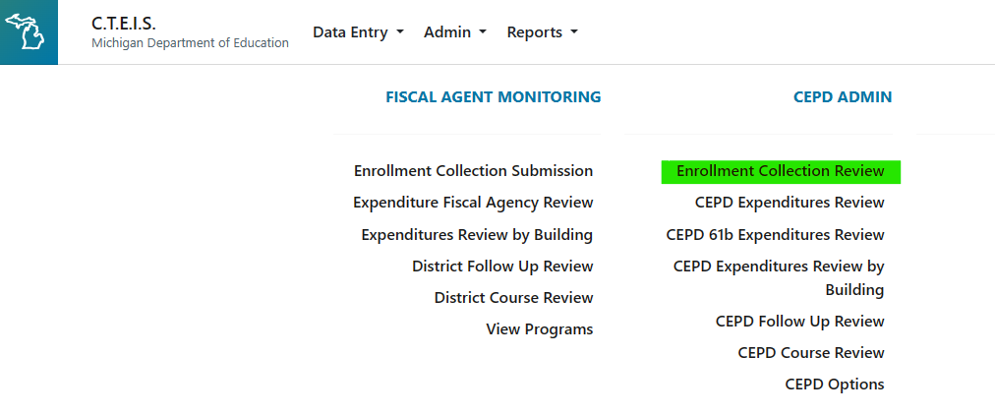
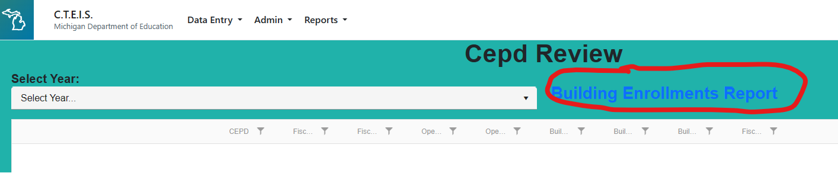
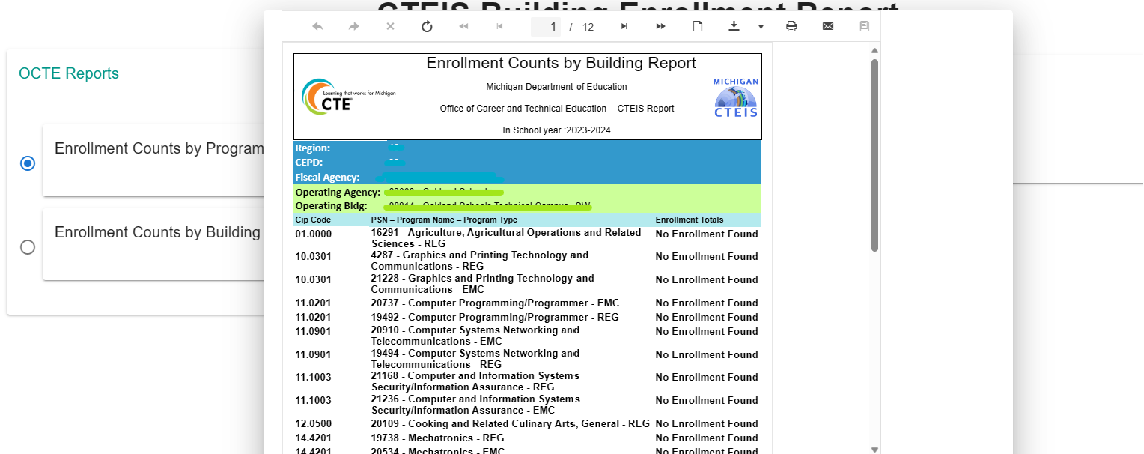
How many CTE Student/Enrollments do I have?
Vital for May 12th Enrollment Requirement!
CEPD Admins
Enrollment Collection Review
Building Enrollment Reports

Slide 8
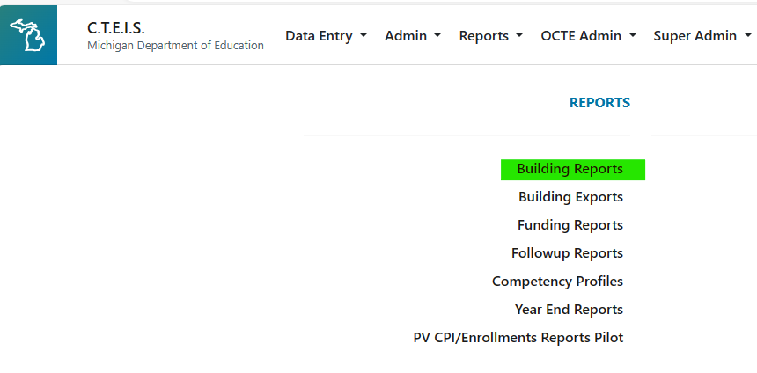
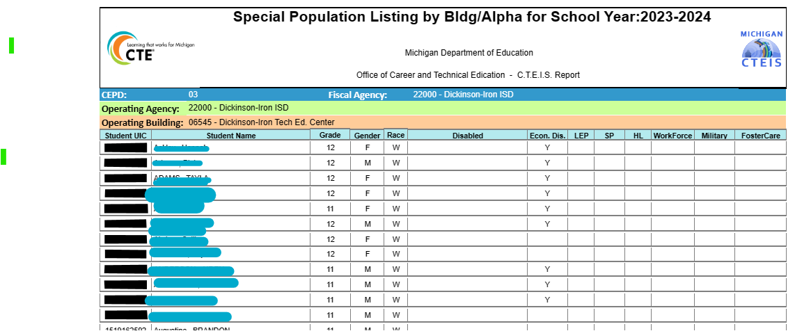
How many CTE Students/Enrollments do I have?
Vital for May 12th Enrollment Requirement!
Building Reports
Special Population Listing by Alpha

Slide 9
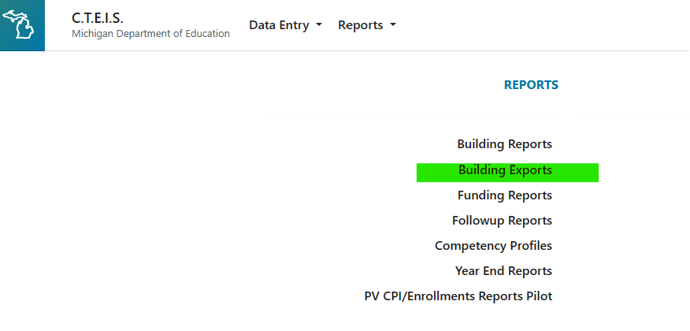
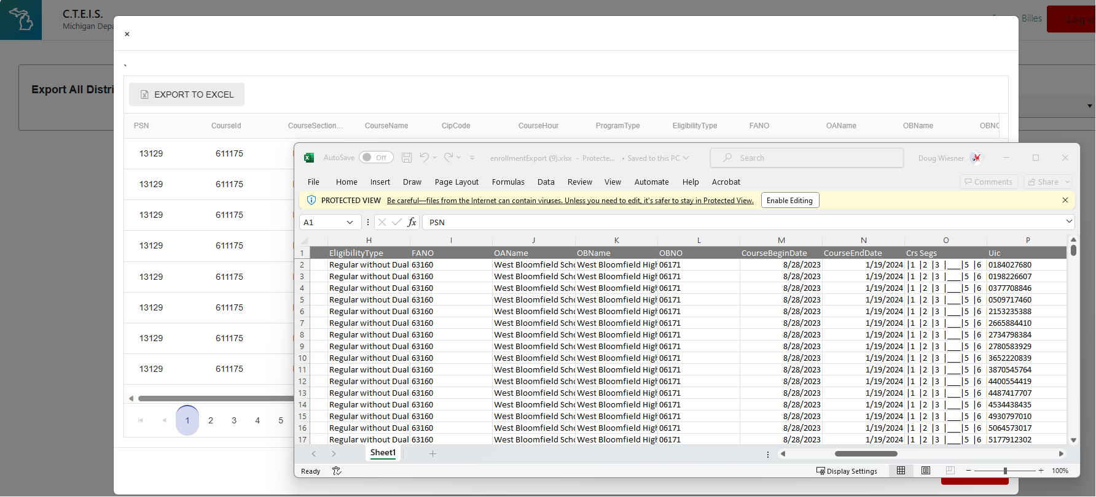
How many CTE Students/Enrollments do I have?
Building Exports
All Currently Enrolled Students
Student Demo
Course Info
Seg/Comp Info
Sending Dist/Bldg
Program Info

Slide 10
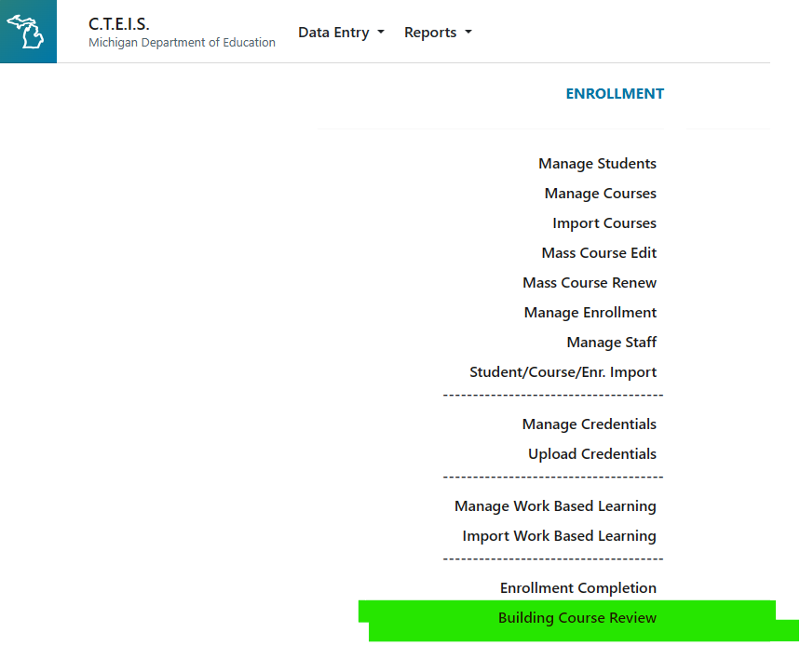
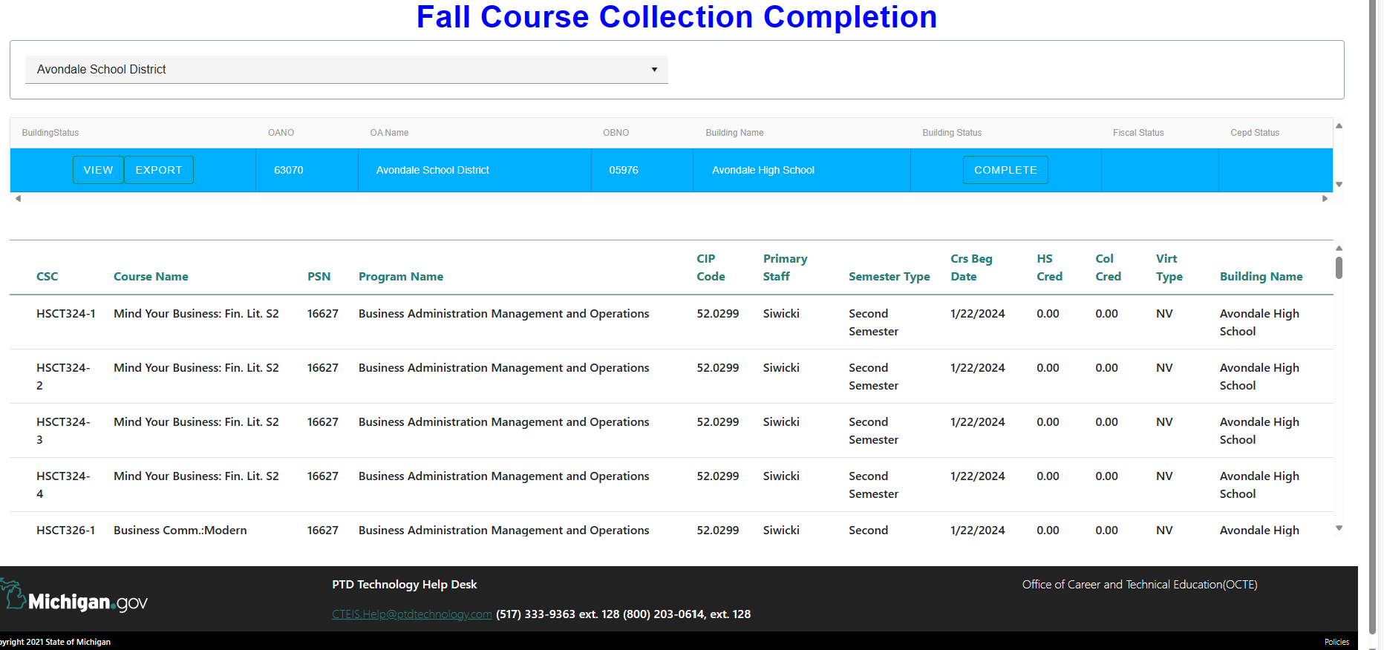
How many courses do I have?
Menu: Building Course Review
View/Export for selected building

Slide 11
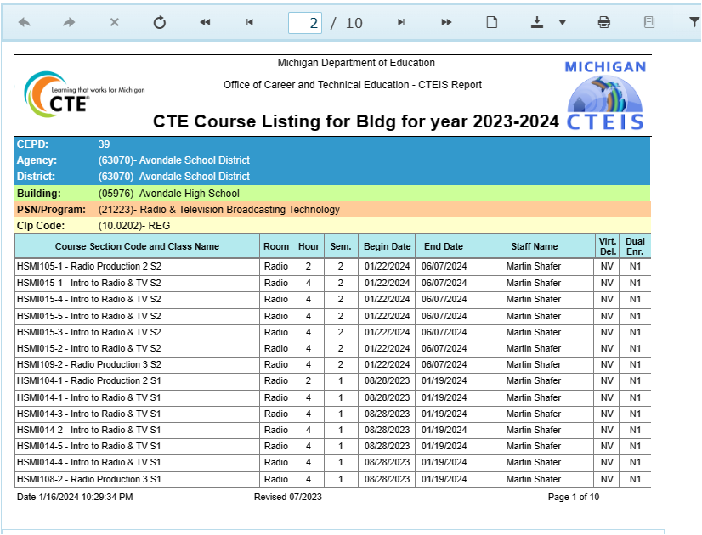
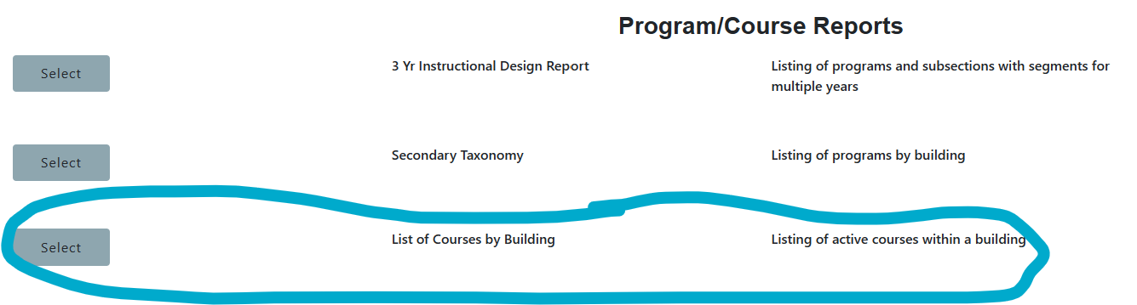
How many courses do I have?
Menu: Reports/Building Reports
Program/Course Reports
List of Courses by Building
And CIP Code

Slide 12
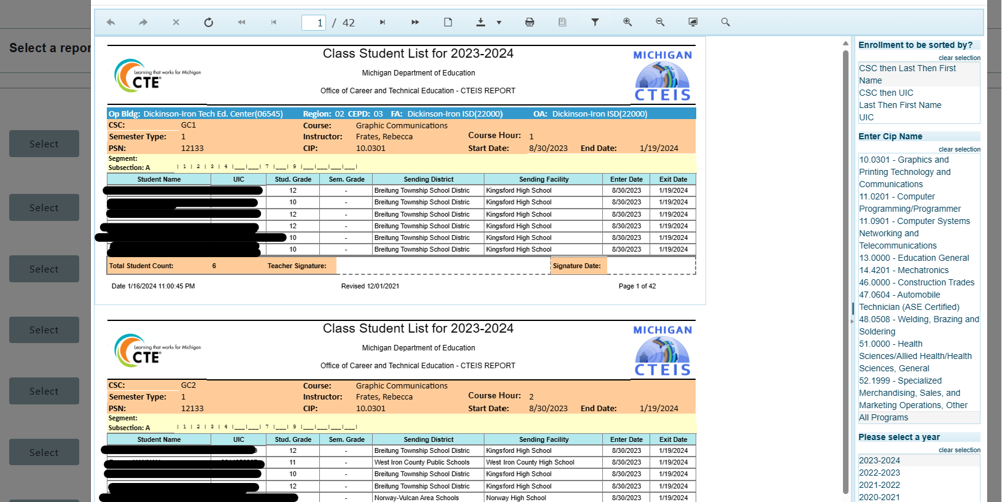

Are my students properly enrolled?
Class Student List Reports
Enrollment Export

Slide 13
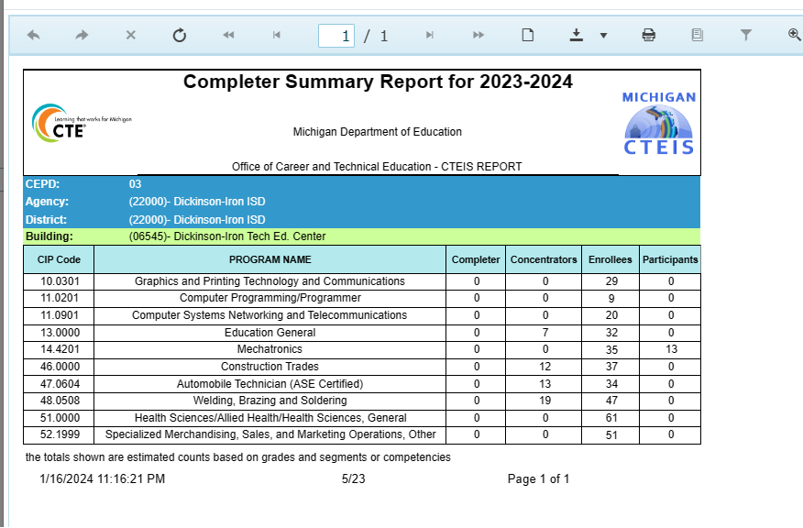
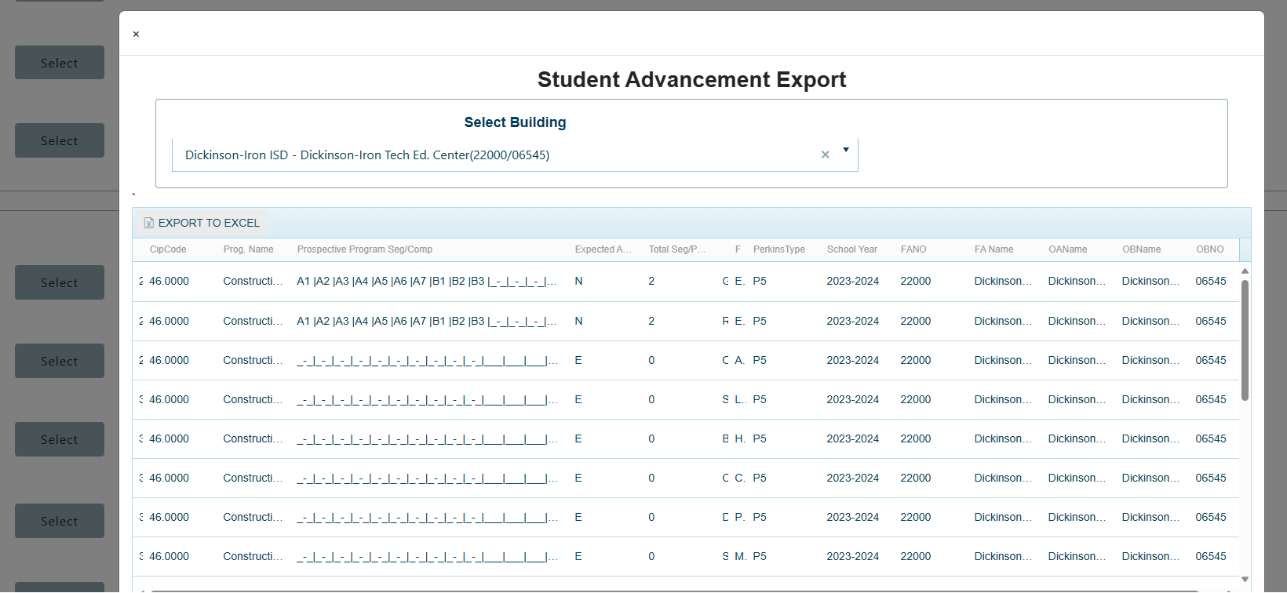
Are my students receiving Segments/Competencies they deserve?
Reports/Building Reports
Completer Summary Report
Student Advancement Export

Slide 14
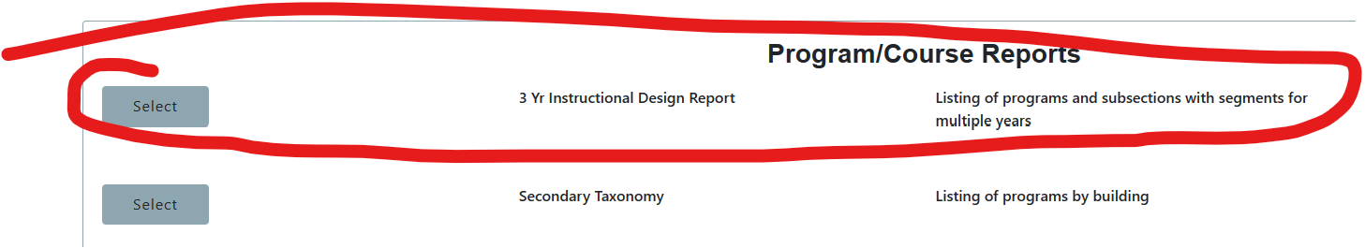
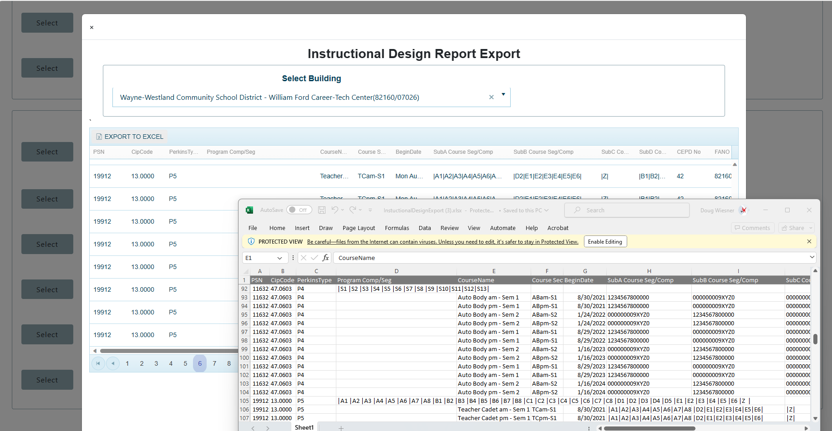
Do my Courses produce Concentrators and Completers?
Menu: Reports/Building Reports
Program/Course Reports
3 Yr Instructional Design Report

Slide 15
Thank You! Questions?
Doug Wiesner, Ph.D.
PTD Technology
Doug.Wiesner@PTDTechnology.com
Slide deck available at
Support.CTEIS.com/Resources/Presentations

